Slide 1
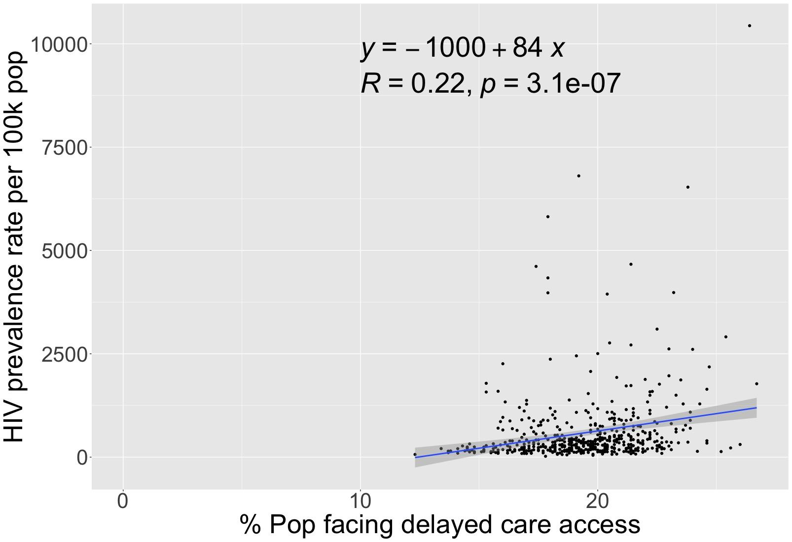
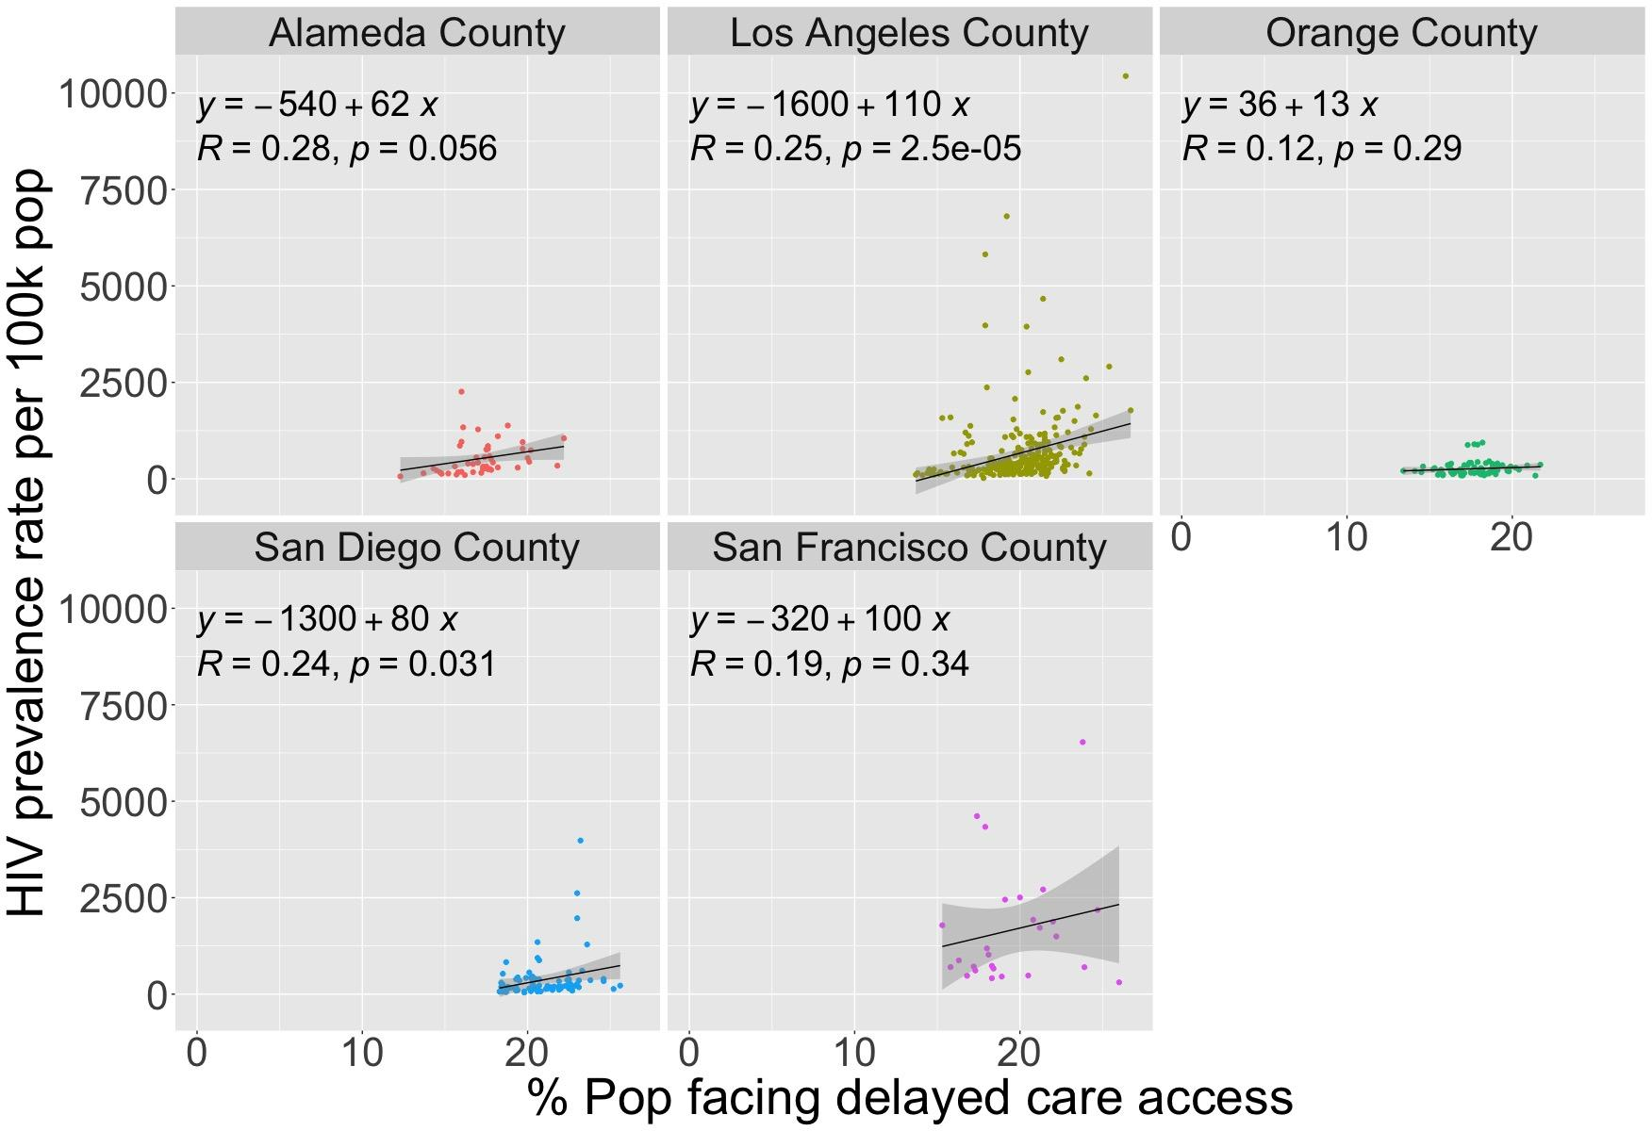
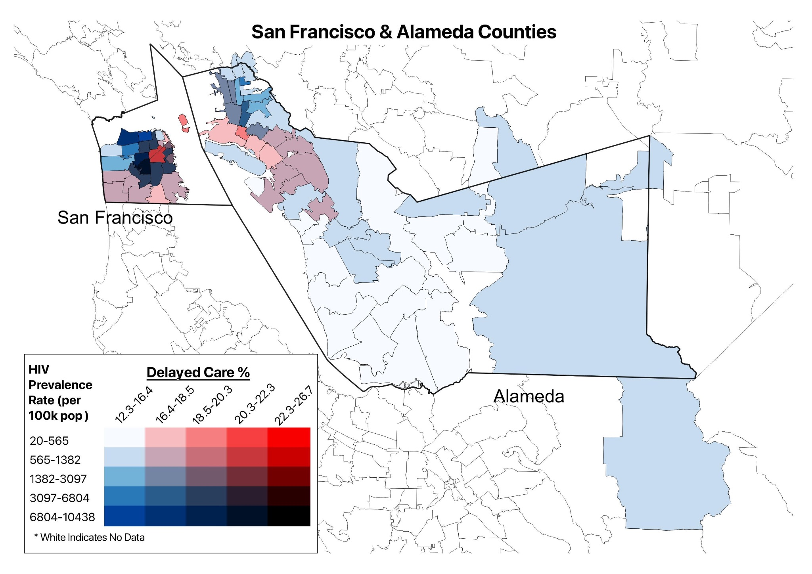
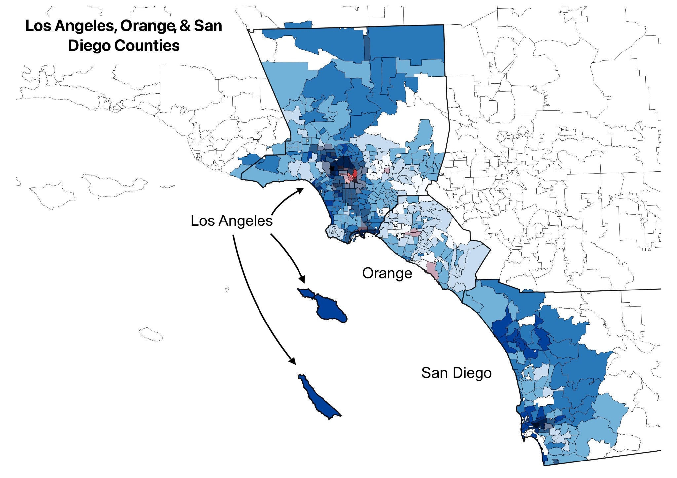
HIV Prevalence and Delay In Care in 5 California Counties
Aliyn Alicea, Urwa Kainat, Hiela Manely, and Andrew Nguyen
Objective
Results
To determine the correlation of 2018 HIV prevalence with delayed care by county and suburban, urban, and rural classifications, using zip code data.
Figure 1: Correlation Between HIV Prevalence Rate & Delayed Care
Introduction & Background
In California, >130,000 people have HIV, with about 4,500 new diagnoses each year.
Underserved communities, especially in urban areas, are disproportionately affected by HIV due to a lack of access to testing, treatment, and prevention services.
Methods & Materials
The AIDSVu database provided HIV prevalence per 100,000 residents by zip codes (n= 508) in 5 California counties: San Francisco, Alameda, Los Angeles, Orange, and San Diego.
The California Health Interview Survey determined population percent reporting delayed medical care.
Zip Codes were classified as rural, suburban, and urban
RStudio produced correlation and linear regression analysis.
Figure 2: Geographic Mapping of HIV Prevalence Rate & Delayed Care by Zip Code
Conclusion
HIV prevalence and delayed care access has a weak but significant positive correlation in some CA counties.
Delaying care can impact the number of individuals being diagnosed with HIV.
% Population reporting delayed care (19.48 ± 0.21%) weakly but significantly positively correlated with HIV prevalence rate per 100k population (589.98 ± 77.96)
Urban areas alongside Los Angeles and San Diego counties had significant correlations.
Policy Implications
Focus on improving early detection through expanded:
HIV testing programs, facilitating linkage to care, and providing comprehensive support services.
Government grants can fund healthcare infrastructure development, HIV testing and treatment services, and community based education.
Acknowledgements
References
Hi
Thank you to the AIDSVu database, UCLA’s CHIS Neighborhood Edition, and San Diego Department of Public Health for providing the data for this project.
We would like to express our sincere gratitude to the University of California San Diego and the Herbert Wertheim School of Public Health.

